Slide 1
Security in
Wireless Network Systems (II)
Week 16
A Case Study:
Overview of WLAN Security

Slide 2
Outline
Overview of Wireless LAN
Security Features of Wireless LAN
WEP and Its Weakness
WPA, WPA2, 802.11i

Slide 3
Wireless Networks
WWAN: 2G cellular, Cellular Digital Packet Data (CDPD), GSM
WMAN: 802.16
WLAN :
  Birth: early 1990s
  Standards: 802.11, HiperLAN
  Wi-Fi : 1995
WPAN: Bluetooth, UWB, ZigBee

Slide 4
802.11 Standards
Standard | Max Bit Rate | Year | Band (GHz) | Radio Tech
802.11 | 2M | 1997 | 2.4 | FHSS/DSSS
802.11a | 54M | 1999 | 5 | OFDM
802.11b | 11M | 1999 | 2.4 | DSSS | Most popular
802.11g | 54M |  | 2.4 | OFDM
802.11n, Turbo G | 108M |  |  |  | Non-standard

Slide 5
802.11 Standards
802.1x: a port-level access control protocol
802.11i: wireless-specific security functions
  ratified in June 2004

Slide 6
802.11 Architecture
Infrastructure Network: based on access points (AP)
  Basic Service Set (BSS)
  Extended Service Set (ESS)
Ad Hoc Network: Peer-to-Peer (P2P) networks

Slide 7
Wireless Equipments
Wireless Station
  Wireless Network Interface Card (NIC)
Access Point
  As a base station
  A bride between wireless and wired networks

Slide 8
Range
Indoors: about 50m
Outdoors: about 400m
AP to AP: typically 2 miles
Can be 15-30 miles using directional antennas

Slide 9
Data Rate
Depends on
  Distance from the AP
  Quality of the radio path and interference encountered

Slide 10
Benefits
User Mobility
Rapid Installation
Flexibility
Scalability

Slide 11
Security of 802.11 WLAN
Wired Equivalent Privacy (WEP)
  Link-level data (Not end-to-end security)
  RC4 static 40-bit key
Shared key authentication
  uses WEP key to authenticate users
MAC address filtering
  address list to restrict access

Slide 12
WEP
Authentication
  Only authorized persons gain access to the network
Confidentiality
  Only authorized persons can view the data
Integrity
  Has the data been tampered with?

Slide 13
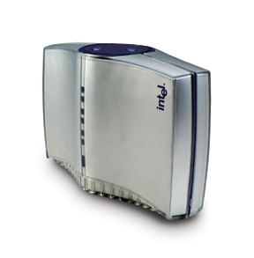

Open-System Authentication
1. From: source (ID: MAC address)
Access Point
Station
2. Welcome!

Slide 14
Shared-Key Authentication
1. From: source (ID – MAC address)
2. Challenge Text (clear)
3. E (Challenge Text)
Station
Access Point
4. Welcome!

Slide 15
Authentication
Open-system authentication
  Without any identity verification
  Simply responds with a MAC address
  The only required form of authentication in 802.11
Shared-key authentication
  A station is allowed to join network if it proves WEP key is shared.
  40-bit RC4 stream cipher is used in the 1-way 2-stage challenge-response scheme
  Suffer from the man-in-the-middle attack

Slide 16
Privacy
RC4 Symmetric Key
40-bit key
Should be > 80-bit key to be safe

Slide 17
Integrity
Encrypted Cyclic Redundancy Check (CRC)
  Frame check sequence: CRC-32
  Per packet
Simple CRC is not as secure as Hash or Message Authentication Code (MAC)

Slide 18
Key Management
Probably the most critical aspect of a cryptographic system
  Was left largely as an exercise
Problems
  WEP keys are non-unique
  Never changing keys
  Factory-default keys
  Weak keys
  Does not scale well because key management is not specified

Slide 19
Encrypted WEP Frame
Plaintext
Message
CRC
⊕
Keystream = RC4(v, k)
v
Cihpertext
Encryption:
C = P ⊕ RC4(v,k)
Decryption:
P’ = C ⊕ RC4(v,k)
= P ⊕ RC4(v,k) ⊕ RC4(v,k)
= P
Transmitted Data

Slide 20
Risks of Keystream Reuse
C1 = P1 ⊕ RC4(v,k)
C2 = P2 ⊕ RC4(v,k)
C1 ⊕ C2
= (P1 ⊕ RC4(v,k)) ⊕ (P1 ⊕ RC4(v,k))
= P1 ⊕ P2
Some PCMCIA cards reset IV to 0 when re-initialized
IV is only 24-bit long

Slide 21
Key Problems with WEP (1)
Security features are frequently not enabled
IVs are short (or even constant)
40-bit Keys are short, shared, static
Keys cannot be updated automatically
RC4 has a weak key schedule
  An efficient analytic attack by analyzing only a small amount of traffic (in hours in some cases)
  The attack is now open source code
Wireless packet analyzer
  AirSnort, WEPcrack, NetStumbler, Pringles Antenna, ….

Slide 22
Key Problems with WEP (2)
Packet integrity is poor: CRC32 is inadequate
  Message modification attacks are possible
No user authentication: only device is authenticated
  Access through stolen client devices
Device authentication is open system authentication or simple shared-key challenge response
  Sniffing software can gain user names and passwords
  Can gain access to wired network

Slide 23
Key Problems with WEP (3)
The client does not authenticate APs (Rogue Aps)
  Malicious Rogue Aps: Pretend to be a legitimate AP (proper configuration) between an authorized AP and wireless clients (stronger signal will do)
  Non-malicious Rogue Aps: without proper security configuration

Slide 24
WEP
Useful for casual home use
Not appropriate for corporate network

Slide 25
Improving Effort
Short term
  Wi-Fi Protected Access (WPA): 2003
  WPA2: 2004
Long term
  802.11i – ratified in Jun 2004
    Using AES
    Require new hardware to implement

Slide 26
WPA Technology
User authentication
  802.1x + EAP (Extensible Authentication Protocol)
  Pre-Shared Key (PSK) for SOHO
Encryption
  Temporal Key Integrity Protocol (TKIP)
  802.1x for dynamic key distribution
Validation
  Message Integrity Check (MIC): Michael

Slide 27
WPA Technology
Automatic key distribution
Per user, per session, unique master key
Unique per packet encryption key

Slide 28
WPA-Certified
802.1x Authentication/Session-based Key Management
Temporal Key Integrity Protocol (TKIP)
  Adopts WEP’s 40-bit RC4 encryption
  Key is changed for each frame
  Message Integrity Check (MIC) to prevent spoofed APs
  Software implementation

Slide 29
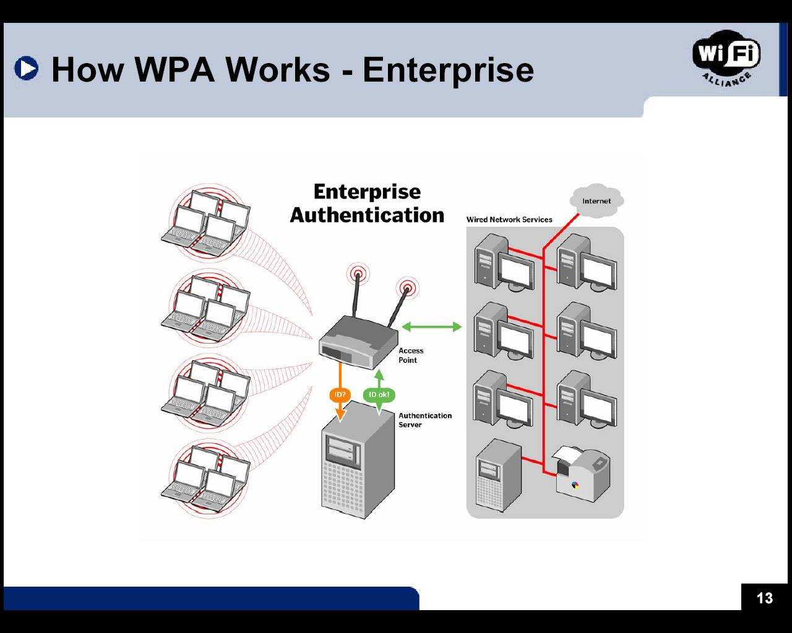
WPA - Enterprise

Slide 30
WPA - SOHO
Authentication: matching passwords
Encryption: identical to enterprise encryption

Slide 31
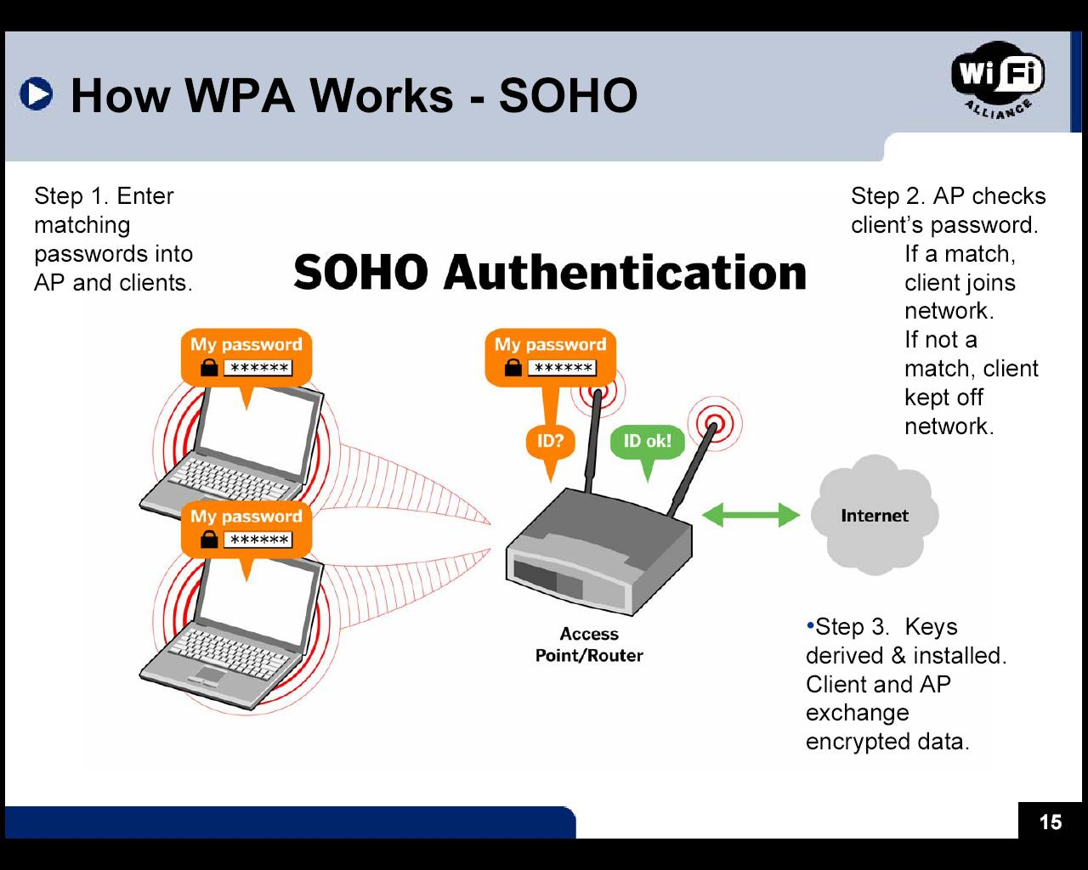
WPA - SOHO

Slide 32
Comparison of WEP and WPA
 | WEP | WPA
Authentication | Flawed: Uses WEP key | Stronger: 802.1x + EAP
Encryption | Cracked | Fixed most flaws
Key length | 40-bit | 128-bit
Key changed? | Same key used by everyone | Dynamic session key
Key Distribution | Manual | Automatic

Slide 33
802.11i Technology
User authentication
  802.1x + EAP (Extensible Authentication Protocol)
  Pre-Shared Key (PSK) for SOHO
Encryption
  AES-CCMP
Validation
  Message Integrity Check (MIC): Michael

Slide 34
Architectural Components
Goals
EAP/802.1X/RADIUS
Operational Phases
  Discovery
  Authentication
  Key Management

Slide 35

Architecture
Out of scope of 802.11i standard
Wireless Station
Access Point
Authentication Server
EAP-TLS
EAP
802.1X (EAPoL)
RADIUS
802.11
UDP/IP

Slide 36
802.11i Operational Phases
Station
Access Point
Authentication Server
Security capabilities discovery
802.1X authentication
802.1X key management
RADIUS-based key distribution
Data protection

Slide 37
Purpose of each phase (1)
Discovery
  Determine promising parties with whom to communicate
  AP advertises network security capabilities to STAs
802.1X authentication
  Centralize network admission policy decisions at the AS
  STA determines whether it wants to communicate
  Mutually authenticate STA and AS
  Generate Master Key as a side effect of authentication
  Use Master Key to generate PMK = authorization token

Slide 38
Purpose of each phase (2)
RADIUS-based key distribution
  AS PMK to STA’s AP
802.1X key management
  Bind PMK to STA and AP
  Confirm both AP and STA possess PMK
  Generate fresh operational key (PTK)
  Prove each peer is live
  Synchronize PTK use

Slide 39
Authentication Components
Wireless Station
Access Point
Authentication Server
EAP-TLS
EAP
802.1X (EAPoL)
RADIUS
802.11
UDP/IP

Slide 40
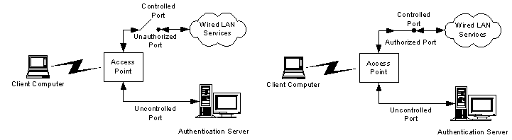
Controlled/Uncontrolled Port Concept

Slide 41
Sample EAP Exchange
Supplicant
Authenticator
1: Request/Identity
2: Response/Identity
3: Request/MD5-Challenge
4: Response/NAK, Generic Token Card
5: Request/Generic Token Card
6: Response/Generic Token Card
7: Response/Success

Slide 42
802.1x EAP - Authentication
IETF RFC 2284
Initially for PPP, but 802.1X extends EAP to 802 LANs
Authentication framework for wired and wireless LANs
Features
  Key distribution
  Port-based authentication
  Supports multiple authentication protocols

Slide 43
EAP
Method Layer
TLS
AKA/SIM
Token Card
EAP
Link Layer
PPP
802.3
802.11

Slide 44
EAP
EAP = Extensible Authentication Protocol
  Defined in RFC 2284
  Being revised due to implementation experience
Design goal: allow easy addition of new authentication methods
  AP need not know about new authentication method
  Affords great flexibility
EAP is a transport optimized for authentication
  not an authentication method
  relies on “concrete” methods plugged into it

Slide 45
EAP
Eases manageability by centralizing
  Authentication decisions
  Authorization decisions
Well matched economically to 802.11
  Minimizes AP cost by moving expensive authentication to AS
  AP unaware of the authentication protocol
EAP supports chained authentications naturally
  First do mutual authentication of devices
  then user authentication, etc…
  … so well suited to multi-factor authentication

Slide 46
Sample 802.1x Exchange
Supplicant
Authenticator
AS
EAPOL
1: EAPOL-Start
2: Request/Identity
3: Response/Identity
3. Radius-Access-Request
4: EAP-Request
4: Radius-Access-Challenge
5: EAP-Response
5: Radius-Access-Response
6: EAP-Success
6: Radius-Access-Accept
Access allowed
7: EAP-Logoff
Access blocked

Slide 47



802.1x EAP Authentication
Access
Point
Client
RADIUS
Start
AP Blocks all Requests until
Authentication Completes
Request Identity
Identity
Identity
RADIUS Server Authenticates Client
Client Authenticates RADIUS Server
Success
Success
Generate Key
Generate Key

Slide 48



EAP Authentication Alternatives
WLAN Client
Access Point
RADIUS server
Corporate
Network
EAP Cisco® Wireless
(AKA LEAP)
Windows NT
password
Challenge/response
Windows NT
password
Cryptographic one-way hashes are used to prove knowledge of the user
password – without sending the password itself
Certificate
PKI certificate
Protected EAP
(PEAP)
Encrypted tunnel provided by certificate
Userid/Password
EG. (OTP)
Client password
Certificate
PKI certificate
EAP-TLS
PKI certificate
Certificate

Slide 49
802.1x Authentication Methods
EAP-MD5
  MD5-Challenge requires username/password
  Vulnerable to dictionary attack
  Does not provide mutual authentication
  Does not provide key derivation

Slide 50
802.1x Authentication Methods
LEAP
  Lightweight Extensible Authentication Protocol
  By Cisco
  A username/password combination is sent to RADIUS for authentication
  Vulnerable to dictionary attack
  Cisco is phasing out LEAP

Slide 51
802.1x Authentication Methods
EAP-TLS
  Defined by IETF
  Creates a TLS session within EAP between supplicant and AS
  PKI-certificate based: both Supplicant and AS need a certificate
  Mutual authentication
    Always requires providing AS certificate on the STA
    Mutual authentication requires providing STA certificates

Slide 52
EAP-TLS
EAP-TLS
  EAP-TLS is not part of 802.11i; neither is any other specific authentication method
  But EAP-TLS is the de facto 802.11i authentication method
  Wi-Fi recommends
    Can meet all 802.11i requirements
    Other widely deployed methods do not
EAP-TLS = TLS Handshake over EAP
  EAP-TLS defined by RFC 2716
  TLS defined by RFC 2246

Slide 53
Example –EAP-TLS (1)
STA
AP
AS
AP-RADIUS Key
802.1X/EAP-Request Identity
802.1X/EAP-Response Identity (My ID)
RADIUS Access Request/EAP-Response Identity
RADIUS Access Challenge/EAP-Request
802.1X/EAP-Request(TLS)
802.1X/EAP-Response(TLS ClientHello(random₁))
RADIUS Access Request/EAP-Response TLS ClientHello
802.1X/EAP-Request(TLS ServerHello(random₂) || TLS Certificate || TLS CertificateRequest || TLS server_key_exchange || TLS server_done)
RADIUS Access Challenge/EAP-Request

Slide 54
Example – EAP-TLS (2)
AS
STA
AP
AP-RADIUS Key
MasterKey = TLS-PRF(PreMasterKey, “master secret” || random₁ || random₂)
802.1X/EAP-Response(TLS client_key_exchange || TLS || TLS certificate || TLS certificateVerify || TLS change_cipher_suite || TLS finished
RADIUS Access Request/EAP-Response
802.1X/EAP-Request(TLS change_cipher_suite || TLS finished)
RADIUS Access Challenge/EAP-Request
802.1X/EAP-Response
RADIUS Access Request/EAP-Response Identity
PMK = TLS-PRF(MasterKey, “client EAP encryption” || random₁ || random₂)
RADIUS Accept/EAP-Success, PMK
802.1X/EAP-Success

Slide 55
802.1x Authentication Methods
EAP-TTLS
  EAP-Tunneled Transport Layer Security (TTLS)
  Sets up a encrypted TLS-tunnel for safe transport of authentication data
  Within the TLS tunnel, (any) other authentication methods may be used
  Developed by Funk Software and Meetinghouse

Slide 56
802.1x Authentication Methods
PEAP
  Protected EAP
  Uses an encrypted TLS-tunnel as EAP-TTLS
  Supplicant certificates for both EAP-TTLS and PEAP are optional, but server (AS) certificates are required
  Developed by Microsoft, Cisco, and RSA Security

Slide 57
802.1x on WLANs
Supplicant
Authenticator
AS
802.11
RADIUS
1: Association Request
2: Association Response
EAPOL
3: EAPOL-Start
4: Request/Identity
5: Response/Identity
5. Radius-Access-Request
6: EAP-Request
6: Radius-Access-Challenge
7: EAP-Response
7: Radius-Access-Response
8: EAP-Success
8: Radius-Access-Accept
9. EAPOL-Key

Slide 58
RADIUS
RADIUS: Remote Authentication Dial-In User Service
RADIUS is not part of 802.11i; back-end protocol is out of scope
  RADIUS is the de facto back-end protocol
  RADIUS defined in RFC 2138
4 messages
  Access-Request – for AP → AS messages
  Access-Challenge – for AS → AP messages forwarded to STA
  Access-Accept – for AS → AP messages indicating authentication success
  Access-Reject – for AS → AP message indicating authentication failure

Slide 59
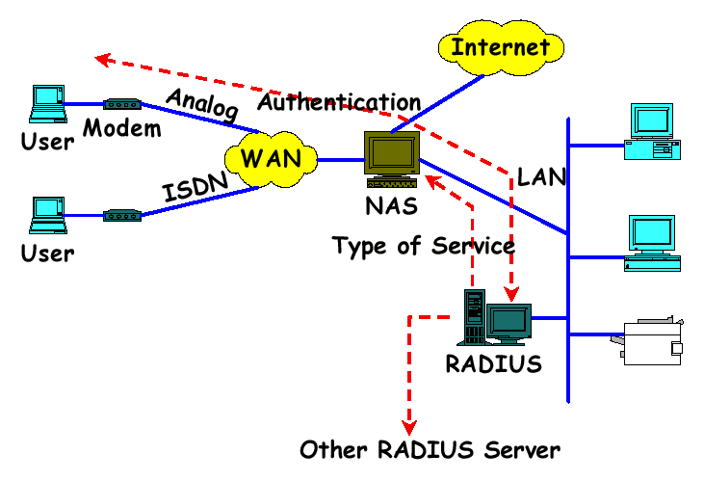
RADIUS Architecture

Slide 60
Authentication Summary
At the end of authentication
  The AS and STA have established a session if concrete EAP method does
  The AS and STA possess a mutually authenticated Master Key if concrete EAP method does
    Master Key represents decision to grant access based on authentication
  STA and AS have derived PMK
    PMK is an authorization token to enforce access control decision
  AS has distributed PMK to an AP (hopefully, to the STA’s AP)

Slide 61
Discovery Overview
AP advertises capabilities in Beacon, Probe Response
  SSID in Beacon, Probe provides hint for right authentication credentials
    Performance optimization only; no security value
  RSN Information Element advertises
    All enabled authentication suites
    All enabled unicast cipher suites
    Multicast cipher suite
STA selects authentication suite and unicast cipher suite in Association Request

Slide 62
Discovery
Station
Access Point
Probe Request
Probe Response + RSN IE (AP supports CCMP Mcast, CCMP Ucast, 802.1X Auth)
802.11 Open System Auth
802.11 Open Auth (success)
Association Req + RSN IE (STA requests CCMP Mcast, CCMP Ucast, 802.1X Auth)
Association Response (success)

Slide 63
Discovery Summary
At the end of discovery
  STA knows
    The alleged SSID of the network
    The alleged authentication and cipher suites of the network
    These allow STA to locate correct credentials, instead of trial use of credentials for every network
  The AP knows which of its authentication and cipher suites the STA allegedly chose
  A STA and an AP have established an 802.11 channel
  The associated STA and AP are ready to authenticate

Slide 64
802.1X Key Management
802.11i data protocols fail without “fresh” keys
Want to use 802.1X framework
New model:
  Derive a Pairwise Master Key (PMK)
  AP and STA use PMK to derive Pairwise Transient Key (PTK)
  Use PTK to protect the link
Limitations:
  No explicit binding to earlier association, authentication
    Relies on temporality, PMK freshness for security
  Keys are only as good as back-end allows

Slide 65
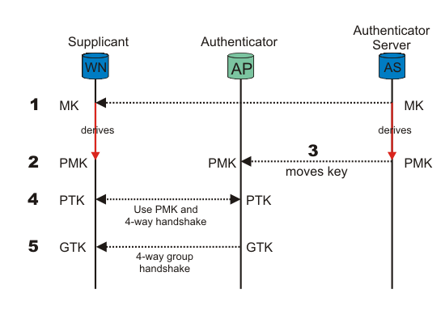

Slide 66
Pairwise Key Hierarchy
Master Key (MK)
Pairwise Master Key (PMK) = TLS-PRF(MasterKey, “client EAP encryption” | clientHello.random | serverHello.random)
Pairwise Transient Key (PTK) = EAPoL-PRF(PMK, AP Nonce | STA Nonce | AP MAC Addr | STA MAC Addr)
Analog of the WEP key
Key Confirmation Key (KCK) – PTK bits 0–127
Key Encryption Key (KEK) – PTK bits 128–255
Temporal Key – PTK bits 256–n – can have cipher suite specific structure

Slide 67
Key Management Overview
STA
AS
AP
Step 1: Use RADIUS to push PMK from AS to AP
Step 2: Use PMK and 4-Way Handshake to derive, bind, and verify PTK
Step 3: Use Group Key Handshake to send GTK from AP to STA

Slide 68
4-Way Handshake
AP
STA
PMK
PMK
Pick Random ANonce
EAPoL-Key(Reply Required, Unicast, ANonce)
Pick Random SNonce, Derive PTK = EAPoL-PRF(PMK, ANonce | SNonce | AP MAC Addr | STA MAC Addr)
EAPoL-Key(Unicast, SNonce, MIC, STA RSN IE)
Derive PTK
EAPoL-Key(Reply Required, Install PTK, Unicast, ANonce, MIC, AP RSN IE)
EAPoL-Key(Unicast, MIC)
Install TK
Install TK

Slide 69
Group Key Handshake
AP
STA
PTK
PTK
Pick Random GNonce, Pick Random GTK
Encrypt GTK with KEK
EAPoL-Key(All Keys Installed, ACK, Group Rx, Key Id, Group , RSC, GNonce, MIC, GTK)
Decrypt GTK
EAPoL-Key(Group, MIC)
unblocked data traffic
unblocked data traffic

Slide 70
Key Management Summary
4-Way Handshake
  Establishes a fresh pairwise key bound to STA and AP for this session
  Proves liveness of peers
  Demonstrates there is no man-in-the-middle between PTK holders if there was no man-in-the-middle holding the PMK
  Synchronizes pairwise key use
Group Key Handshake provides group key to all STAs

Slide 71

Pre-shared Key
Wireless Station
PSK, used directly as a PMK
AP
802.11 security capabilities discovery
Enhanced 802.1X key mgmt (no authentication)
CCMP, WRAP, or TKIP

Slide 72
TSN = TKIP + 802.1X = WPA(1)
RSN = CCMP + 802.1X = WPA2
802.11i
  TKIP
  CCMP
  802.1X
  And other ….

Slide 73
Pre-authentication
1
1
2
AP 1
AS
2
STA
2
3
AP 2

Slide 74
802.11i Summary
New 802.11i data protocols provide confidentiality, data origin authenticity, replay protection
These protocols require fresh key on every session
Key management delivers keys used as authorization tokens, proving channel access is authorized
Architecture ties keys to authentication

